Slide 1

Data Mining Fungsi Asosiasi
Tutik Khotimah, S.Kom, M.Kom

Slide 2

Tujuan Instruksional
Menjelaskan Fungsi Asosiasi
Menjelaskan Fungsi Asosiasi
Menjelaskan Support & Confidence
Menjelaskan A Priori

Slide 3
Fungsi Asosiasi
Termasuk dalam metode learning Association Learning
Analisis asosiasi merupakan teknik data mining untuk menemukan aturan assosiatif antara suatu kombinasi item. Aturan asosiasi disebut juga affinity analysis.
Analisis asosiasi digunakan untuk analisa transaksi belanja (Market Basket Analysis)
Konsep utama dalam asosiasi adalah mencari “produk/item yang dibeli bersamaan” dengan pola “if antecedent then consequent”
Algoritma yang dapat digunakan antara lain: A Priori, FP Growth, CT Pro

Slide 4
Support & Confidence
Support adalah nilai penunjang atau persentase kombinasi sebuah item dalam database
Confidence adalah nilai kepastian yaitu kuatnya hubungan antar item dalam aturan asosiasi.
Contoh:
{kurma, madu} → {minyak zaitun} (support = 40%, confidence = 50%)
Arttinya: 50% dari transaksi di database yang memuat item kurma dan madu, transaksi tersebut juga memuat minyak zaitun. Sedangkan 40% dari seluruh transaksi di database memuat ketiga item tersebut.
Jadi, seorang konsumen yang membeli kurma dan madu, memiliki kemungkinan sebesar 50% untuk membeli minyak zaitun. Aturan ini cukup signifikan karena transaksi yang berisi kurma, madu, dan minyak zaitun memiliki prosentase 40% dari keseluruhan transaksi.

Slide 5
Support & Confidence
Support
Support (A) = Jumlah transaksi yang mengandung A
Total seluruh transaksi
Support (A∩B) = Jumlah transaksi yang mengandung A dan B
Total seluruh transaksi
Confidence
Aturan A → B
Confidence = P (B|A) = Jumlah transaksi yang mengandung A dan B
Jumlah transaksi yang mengandung A

Slide 6
Support & Confidence
Contoh
Pada hari Sabtu malam, 1000 pelanggan telah melakukan belanja di supermaket ABC, dimana:
200 orang membeli Susu
dari 200 orang yang membeli susu, 50 orangnya membeli Coklat
Association rule: “Jika membeli susu, maka membeli coklat”, dengan nilai support = 200/1000 = 1/5=20% dan nilai confidence = 50/200 = 1/4=25%

Slide 7
A Priori
Merupakan algoritma untuk asosiasi
Melakukan pencarian frequent itemset dengan menggunakan teknik association rule
Frequent itemset adalah sekumpulan item yang sering muncul secara bersamaan
Pola dari association rule adalah “if antecedent then consequent”
Pengukuran menggunakan nilai support dan confidence

Slide 8
Langkah Algoritma A Priori
Let k=1
Generate frequent itemsets of length 1
Repeat until no new frequent itemsets are identified
Generate length (k+1) candidate itemsets from length k frequent itemsets
Prune candidate itemsets containing subsets of length k that are infrequent
Count the support of each candidate by scanning the DB
Eliminate candidates that are infrequent, leaving only those that are frequent

Slide 9
Contoh
Transformasi
Transaksi | Tanaman yang dibeli
1 | Anggur, Pisang, Delima
2 | Anggur, Kurma, Zaitun
3 | Anggur, Pisang, Zaitun
4 | Kurma, Delima
5 | Anggur, Pisang, Kurma, Tin
Kode | Nama Tanaman
A | Anggur
B | Pisang
C | Kurma
D | Delima
E | Tin
F | Zaitun
Transaksi | Tanaman yang dibeli
1 | A, B, D
2 | A, C, F
3 | A, B, F
4 | C, D
5 | A, B, C, E

Slide 10
Contoh
Himpunan Kosong = {}
Himpunan 1 Item Set = {A}, {B}, {C}, {D}, {E}, {F}
Himpunan 2 Item Set = {AB}, {AC}, {AD}, {AE}, {AF}, {BC}, {BD}, {BE}, {BF}, {CD}, {CE}, {CF}, {DE}, {DF}, {EF}
Himpunan 3 Item Set = {ABC}, {ABD}, {ABE}, {ABF}, {ACD}, {ACE}, {ACF}, {ADE}, {ADF}, {AEF}, {BCD}, {BCE}, {BCF}, {BDE}, {BDF}, {BEF}, {CDE}, {CDF}, {CEF}, {DEF}
Himpunan 4 Item Set = {ABCD}, {ABCE}, {ABCF}, {ABDE}, {ABDF}, {ABEF}, {ACDE}, {ACDF}, {ACEF}, {ADEF}, {BCDE}, {BCDF}, {BCEF}, {BDEF}, {CDEF}
Himpunan 5 Item Set = {ABCDE}, {ABCDF}, {ABCEF}, {ABDEF}, {ACDEF},{BCDEF}
Himpunan 6 Item Set = {ABCDEF}

Slide 11
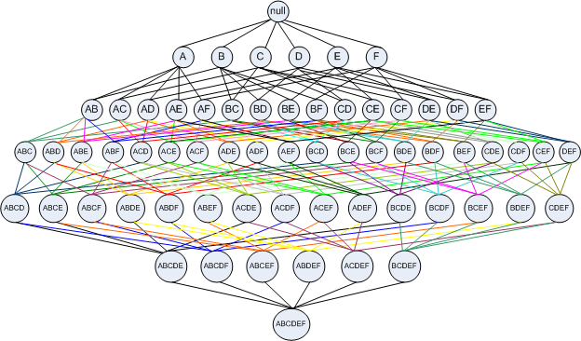
Contoh
Gambar Pohon

Slide 12
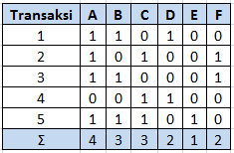
Contoh
Iterasi 1 K=1 (Item Set=1)
Frequent Item Set
A = 4
B = 3
C = 3
D = 2
E = 1
F = 2
Karena semua himpunan memenuhi ɸ, maka semua himpunan dilanjutkan iterasi berikutnya
Menentukan Frequent Item Set minimal, misal ɸ = 1

Slide 13
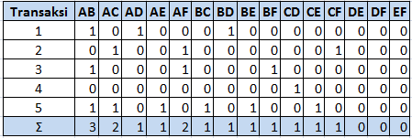
Contoh
Iterasi 2 K=2 (Item Set=2)
Item Set yang memenuhi ɸ antara lain: AB, AC, AD, AE, AF, BC, BD, BE, BF, CD, CE dan CF
Sedangkan DE, DF, dan EF tidak memenuhi syarat sehingga harus dipangkas artinya tidak dilanjutkan dalam iterasi berikutnya

Slide 14
Contoh
Rule dari iterasi ke-2 antara lain
A → B Support P(AB) = 3/5 *100% = 60% Confidence P(B|A) = 3/4 *100% = 75% | B → A Support P(AB) = 3/5 *100% = 26% Confidence P(A|B) = 3/3 *100% = 100%
A→ C Support P(AC) = 2/5 *100% = 40% Confidence P(C|A) = 2/4 *100% = 50% | C→ A Support P(AC) = 2/5 *100% = 40% Confidence P(A|C) = 2/3 *100% = 66,67%
A → D Support P(AD) = 1/5 *100% = 20% Confidence P(D|A) = 1/4 *100% = 25% | D→ A Support P(AD) = 1/5 *100% = 20% Confidence P(A|D) = 1/2 *100% = 50%
A → E Support P(AE) = 1/5 *100% = 20% Confidence P(E|A) = 1/4 *100% = 25% | E→ A Support P(AE) = 1/5 *100% = 20% Confidence P(A|E) = 1/1 *100% = 100%
A → F Support P(AF) = 2/5 *100% = 40% Confidence P(F|A) = 2/4 *100% = 50% | F→ A Support P(AF) = 2/5 *100% = 40% Confidence P(A|F) = 2/2 *100% = 100%
B→ C Support P(BC) = 1/5 *100% = 20% Confidence P(C|B) = 1/3 *100% = 33,33% | C → B Support P(BC) = 1/5 *100% = 20% Confidence P(B|C) = 1/3 *100% = 33,33%
B→ D Support P(BD) = 1/5 *100% = 20% Confidence P(D|B) = 1/3 *100% = 33,33% | D → B Support P(BD) = 1/5 *100% = 20% Confidence P(B|D) = 1/2 *100% = 50%

Slide 15
Contoh
B → E Support P(BE) = 1/5 *100% = 20% Confidence P(E|B) = 1/3 *100% = 33,33% | E → B Support P(BE) = 1/5 *100% = 20% Confidence P(B|E) = 1/1 *100% = 100%
B→ F Support P(BF) = 1/5 *100% = 20% Confidence P(F|B) = 1/3 *100% = 33,33% | F→ B Support P(BF) = 1/5 *100% = 20% Confidence P(B|F) = 1/2 *100% = 50%
C → D Support P(CD) = 1/5 *100% = 20% Confidence P(D|C) = 1/3 *100% = 33,3% | D→ C Support P(CD) = 1/5 *100% = 20% Confidence P(C|D) = 1/2 *100% = 50%
C → E Support P(CE) = 1/5 *100% = 20% Confidence P(E|C) = 1/3 *100% = 33,33% | E→ C Support P(CE) = 1/5 *100% = 20% Confidence P(C|E) = 1/1 *100% = 100%
C → F Support P(CF) = 1/5 *100% = 20% Confidence P(F|C) = 1/3 *100% = 33,33% | F→ C Support P(CF) = 1/5 *100% = 20% Confidence P(C|F) = 1/2 *100% = 50%
D→ E Support P(DE) = 0/5 *100% = 0% Confidence P(E|D) = 0/2 *100% = 0% | E → D Support P(DE) = 0/5 *100% = 0% Confidence P(D|E) = 0/2 *100% = 0%
D→ F Support P(DF) = 0/5 *100% = 0% Confidence P(F|D) = 0/2 *100% = 0% | F → D Support P(DF) = 0/5 *100% = 0% Confidence P(D|F) = 0/2 *100% = 0%
E→ F Support P(EF) = 0/5 *100% = 0% Confidence P(F|E) = 0/1 *100% = 0% | F → E Support P(EF) = 0/5 *100% = 0% Confidence P(E|F) = 0/2 *100% = 0%

Slide 16
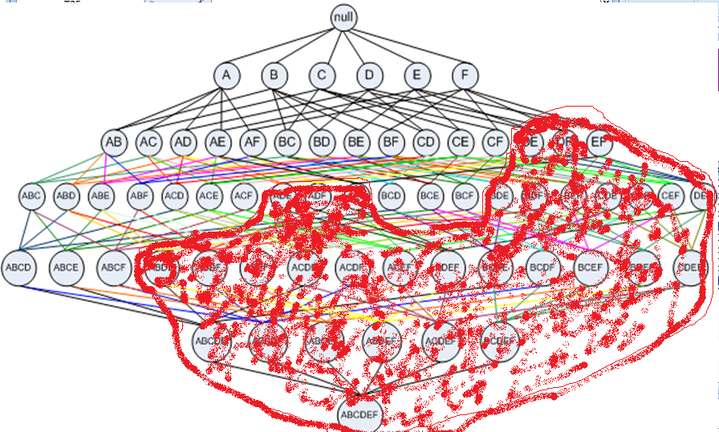
Contoh
Gambar Pemangkasan Pohon

Slide 17
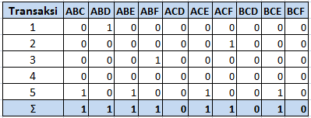
Contoh
Iterasi 3 K=3 (Item Set=3)
Item Set yang memenuhi ɸ antara lain: ABC, ABD, ABE, ABF, ACE, ACF, dan BCE
Sedangkan ACD, BCD, dan BCF tidak memenuhi syarat sehingga harus dipangkas artinya tidak dilanjutkan dalam iterasi berikutnya

Slide 18
Contoh
Rule dari iterasi ke-3 antara lain
AB → C Support P(ABC) = 1/5 *100% = 20% Confidence P(C|AB) = 1/3 *100% = 33,33% | AC → B Support P(ABC) = 1/5 *100% = 20% Confidence P(B|AC) = 1/2 *100% = 50% | BC → A Support P(ABC) = 1/5 *100% = 20% Confidence P(A|BC) = 1/1 *100% = 100%
AB → D Support P(ABD) = 1/5 *100% = 20% Confidence P(D|AB) = 1/3 *100% = 33,33% | AD → B Support P(ABD) = 1/5 *100% = 20% Confidence P(B|AD) = 1/1 *100% = 100% | BD → A Support P(ABD) = 1/5 *100% = 20% Confidence P(A|BD) = 1/1 *100% = 100%
AB → E Support P(ABE) = 1/5 *100% = 20% Confidence P(E|AB) = 1/3 *100% = 33,33% | AE → B Support P(ABE) = 1/5 *100% = 20% Confidence P(B|AE) = 1/1 *100% = 100% | BE → A Support P(ABE) = 1/5 *100% = 20% Confidence P(A|BE) = 1/1 *100% = 100%
AB → F Support P(ABF) = 1/5 *100% = 20% Confidence P(F|AB) = 1/3 *100% = 33,33% | AF → B Support P(ABF) = 1/5 *100% = 20% Confidence P(B|AF) = 1/2 *100% = 50% | BF → A Support P(ABF) = 1/5 *100% = 20% Confidence P(A|BF) = 1/1 *100% = 100%
AC → D Support P(ACD) = 0/5 *100% = 0% Confidence P(D|AC) = 0/2 *100% = 0% | AD → C Support P(ACD) = 0/5 *100% = 0% Confidence P(C|AD) = 0/1 *100% = 0% | CD → A Support P(ACD) = 0/5 *100% = 0% Confidence P(A|CD) = 0/1 *100% = 0%

Slide 19
Contoh
Rule dari iterasi ke-3 antara lain
AC → E Support P(ACE) = 1/5 *100% = 20% Confidence P(E|AC) = 1/2 *100% = 50% | AE → C Support P(ACE) = 1/5 *100% = 20% Confidence P(C|AE) = 1/1 *100% = 100% | CE → A Support P(ABE) = 1/5 *100% = 20% Confidence P(A|CE) = 1/1 *100% = 100%
AC → F Support P(ACF) = 1/5 *100% = 20% Confidence P(F|AC) = 1/2 *100% = 50% | AF → C Support P(ACF) = 1/5 *100% = 20% Confidence P(C|AF) = 1/2 *100% = 50% | CF → A Support P(ACF) = 1/5 *100% = 20% Confidence P(A|CF) = 1/1 *100% = 100%
BC → D Support P(BCD) = 0/5 *100% = 0% Confidence P(D|BC) = 0/1 *100% = 0% | BD → C Support P(BCD) = 0/5 *100% = 0% Confidence P(C|BD) = 0/1 *100% = 0% | CD →B Support P(BCD) = 0/5 *100% = 0% Confidence P(B|CD) = 1/1 *100% = 100%
BC → E Support P(BCE) = 1/5 *100% = 20% Confidence P(E|BC) = 1/1 *100% = 100% | BE → C Support P(BCE) = 1/5 *100% = 20% Confidence P(C|BF) = 1/1 *100% = 100% | CE → B Support P(BCE) = 1/5 *100% = 20% Confidence P(B|CE) = 1/1 *100% = 100%
BC → F Support P(BCF) = 0/5 *100% = 0% Confidence P(F|BC) = 0/1 *100% = 0% | BF → C Support P(BCF) = 0/5 *100% = 0% Confidence P(C|BF) = 0/1 *100% = 0% | CF → B Support P(BCF) = 0/5 *100% = 0% Confidence P(B|CF) = 0/1 *100% = 0%

Slide 20
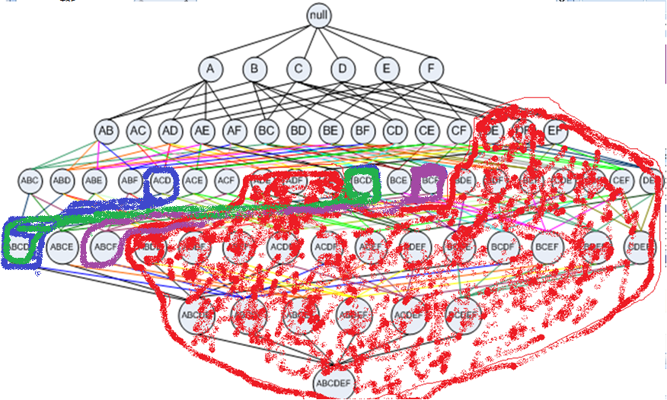
Contoh
Gambar Pemangkasan Pohon

Slide 21
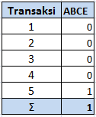
Contoh
Iterasi 4 K=4 (Item Set=4)
Iterasi dihentikan pada k=4 karena hanya memiliki 1 anggota
Rule dari iterasi ke-4 antara lain
ABC → E
Support P(ABCE) = 1/5 *100% = 20%
Confidence P(E|ABC) = 1/1 * 100% = 100%
ABE → C
Support P(ABCE) = 1/5 *100% = 20%
Confidence P(C|ABE) = 1/1 * 100% = 100%
ACE → B
Support P(ABCE) = 1/5 *100% = 20%
Confidence P(B|ACE) = 1/1 * 100% = 100%
BCE → A
Support P(ABCE) = 1/5 *100% = 20%
Confidence P(A|BCE) = 1/1 * 100% = 100%

Slide 22
Tugas Individu
Transaksi | Item yang dibeli
1 | A, D, F
2 | D, F, A
3 | D, E, F
4 | A, D, E, F
5 | E
6 | A, D
7 | A, C
8 | A, F
9 | E, F
10 | A, B, C, D, E, F

Slide 23
Terima Kasih

